Slide 1

READ WRITE INC. Phonics
“… a synthetic phonics programme that ensures reading, writing and spelling success.”

Slide 2
Before we begin…
Systematic phonics
Teaches children letter-sound correspondences in an organised, explicit and sequenced way. This is in contrast to an incidental approach.
Analytic phonics
Children are taught to analyse the letter-sound relationships, once the word is identified. The emphasis is on the initial sound of the word, onset, rime and word families.
Synthetic phonics
With this approach, before children are introduced to books, they are taught letter sounds. After the first few of these have been taught they are shown how these sounds can be blended together to build up words. Defining characteristics are sounding out and blending.
Notes:
Helpful terms.
Different approaches have been used to teach phonics systematically. All use a planned, sequential introduction of a set of phonic elements along with teaching and practice of those elements…
Analytic phonics – Whole-to-part approach – teaching is in the context of sight words e.g. pet, park, push
Synthetic phonics – part-to-whole approach. Pronounce each sound and blend them together to make the word. C – A - T
Other approaches include embedded phonic, analogy phonics and onset-rime approaches

Slide 3
What is it?
“… a dynamic literacy programme based on the rigorous teaching of synthetic phonics. It is designed to get all children reading and writing quickly and easily. The training and resources provide schools with a cohesive and consistent approach to the teaching of phonics and literacy, and to effective classroom management strategies to ensure success for every child.”
According to the website, RWI is currently used in more than a quarter of UK primary schools.
Developed by Ruth Miskin
Reception – Year 2 (Can use materials up to Year 4)
Whole school approach
Input should be for 60 minutes daily
Notes:
VIDEO: http://www.ruthmiskin.com/en/resources/read-write-inc-phonics/
Quote from: Government produced documents to help schools choose phonics teaching programme. Asked publishers to complete a ‘self-assessment’ form detailing how their product meets governments core criteria for an effective synthetic phonics programme. https://www.gov.uk/government/publications/phonics-self-assessment-form-read-write-inc
20-25 minutes daily when learning first sounds, then 10-15 minutes daily for phonics and 30-50 minutes for storybook sessions.
Ruth Miskin – According to the website, one of the UK’s leading authorities on teaching children to read. Was a headteacher in Tower Hamlets. Also been an advisor to the government on literacy teaching since 1997. Concerns have been expressed that she has played an influential role in policy and curriculum development, whilst also having a commercial interest.

Slide 4
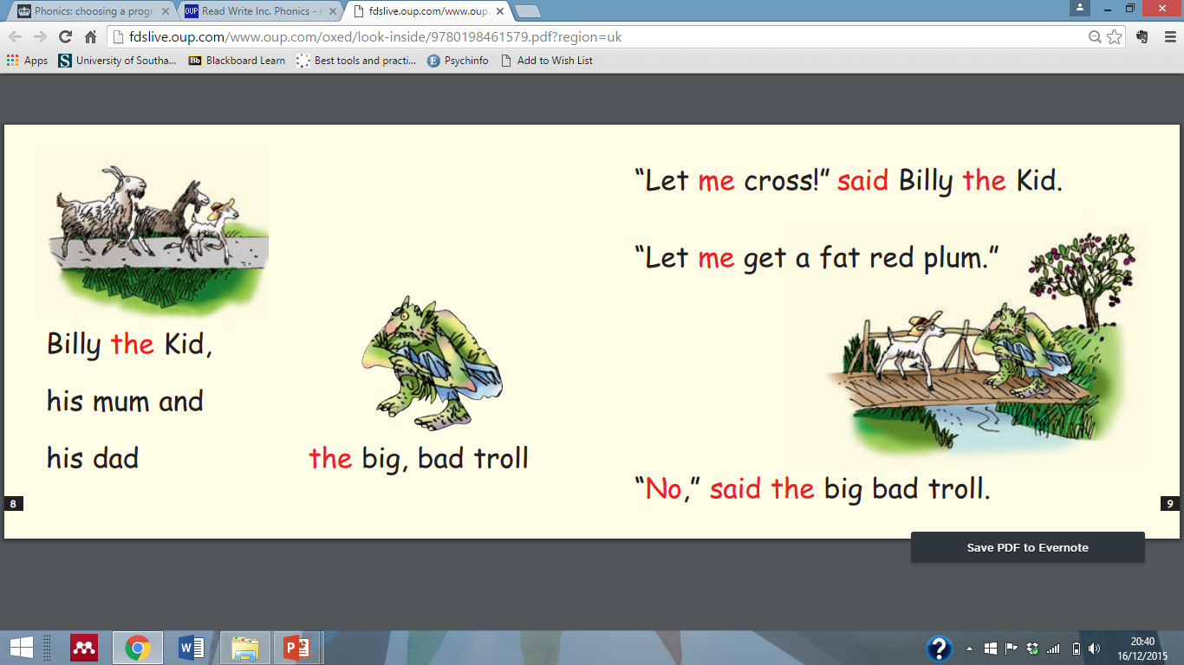
What’s involved?
Speed sounds
Each of the 44 sounds and corresponding letters are introduced and taught individually.
Fred talk
Storybooks
Read story three times. 1. Decode – 2. comprehension – 3. Discussion
Get Writing! Activities
- Each child has a book, in which they practice spellings, building a sentence and write based on picture prompts.
http://fdslive.oup.com/www.oup.com/oxed/look-inside/9780198461579.pdf?region=uk
Notes:
Speed sounds
The 44 sounds and corresponding letters are introduced and taught systematically. One sound is the focus of each speed sounds lesson, during which children:
Listen to and say sound
Read sound using the picture
Write sound using picture-phrase
Can buy lesson plans for all the speed sound lessons
Choral work.
Fred Talk – children introduced to this character once they know group of sounds. Use a toy/puppet. Says, reads and spells word in pure sounds, never says whole word so children do this for him. “Best way for teachers to become fluent in Fred Talk is to do training.”
Storybooks:
100 storybooks and 35 non-fiction titles for further phonics practice. These are described as ‘lively and decodable’, could be argued as to how interesting and motivating they are.
Once children know set 1 sounds at speed and can blend, move on to ‘ditty’ books. These are meant to be a bridge between reading single words and stories.
Before reading storybook, teacher reviews sounds they know and gets children to practice reading words. Teacher introduces story and emphasises vocabulary
Children read story 3 times. Once to decode, second to check comprehension, third to discuss in depth. They do this in reading pairs,
“Our special ‘three reads’ approach ensures every child gains accuracy, fluency and a good understanding of the text”
Get writing! Books, one for each child. Practice spellings, holding and building a sentence and write based on picture prompts.

Slide 5
What’s involved?
Five underlying principles
1. Pace
2. Praise
3. Purpose
4. Participation
5. Passion
As well as…
Repetition, ability grouping, ongoing assessment, fidelity to the teaching programme
Notes:
Pace – aim to complete programme as quickly as possible. Based on view that “the more quickly children learn to read, the more they want to and the more they understand.” No downtime, ‘silent signals’ used for class management e.g. silent stop signal (hand in air) & my turn, your turn for choral work
Praise – teacher praises teaching partners. ‘Praise phrases’ for teaching partner to use (super sounds/wondrous words/remarkable reading) & praise actions to keep children energetic (fireworks and wooshes, microwaves)
Purpose – Made explicit at beginning of each activity. Teacher uses modelling and thinking out loud to make this clear
Participation – choral work and partner work
Passion – make teaching larger than life. Exaggerate modelling of thinking and behaviour.
Assessment Children are assessed and grouped according to ability and these are adjusted regularly, as appropriate.
Fidelity to the teaching programme…
Training – initial 2 day training for whole school. No cascade training. Encouraged to continue to have development days and follow up trainings.
Resources – lots of these! As well as storybooks and get writing books, visuals and lesson plans.
Delivery – school should identify a RWI manager. They are responsible for overseeing the programme and ensuring fidelity. Should be released for the RWI teaching sessions, so they are able to work with those delivering the sessions,.

Slide 6
What’s it based on?
Simple View of Reading
Word recognition
Language comprehension
Notes:
Reading wars – Educationalists, government, psychologists have been engaged in heated discussions around the most effective way of teaching children to read for many years now. Read Write Inc sits within the wider, political context of the National Curriculum and literacy practice in schools. Not enough time to go into details, but in summary…
1988, The National Curriculum was introduced by the conservative government. Mixed approach to reading continued to be practiced in schools. Literacy standards did not significantly rise.
In 1998 the new Labour Government launched its National Literacy Strategy. This was designed in consultation with all the competing factions in the reading wars. As a result compromises were made: several ways of learning to read were, once again, recommended. “literacy hour”, which formed part of this Strategy, was split into four reading-related activities, with only 15 minutes allotted to phonics. Felt this caused confusion and NLS did not live up to expectations.
2005, the Government commissioned Jim Rose, formerly Director of Inspections at OFSTED, to conduct an independent review into the teaching of early reading in England. His report, published in 2006, came down firmly on the side of synthetic phonics. Proposed model known as ‘Simple view of reading’ . This suggests reading has two essential components, word recognition and language comprehension. Both are necessary for reading, but model recommends that teachers keep the two elements separate in minds when planning teaching.
Clear focus on word recognition skills, through phoneme awareness and phonics teaching. Also, repetition and teaching of tricky words. This model suggests that boosting decoding or word reading skills may by itself lead to an increase in reading comprehension
In 2007, the Government issued new guidance, recommending synthetic phonics to all primary schools. Many teachers objected & felt phonics was prescriptive. Many primary schools complied with requirements by increasing time spent on phonics, but still using mixed methods.
In 2012, introduced the phonic screening check for children at the end of Year 1. This aims to check children have “learned phonic decoding to an age-appropriate standard.” Children are asked to read a total of 40 words – 20 real words and 20 made up words. Controversy around this – criticisms include that this does not assess reading for meaning/may confuse children with nonsense words/not linked to later outcomes/
The 2014 National Curriculum continues to emphasise the importance of using a systematic, synthetic phonics approach to teach reading.

Slide 7
What’s it based on?
Reading schemes
Series of specially written books
Based on premise that written English is largely irregular and difficult to learn, so needs to be simplified for beginner readers
Books consist of carefully controlled, restricted vocabulary that are introduced gradually and repeated frequently
(Solity & Vousden, 2009)

Slide 8
What does the evidence say?
Mainly case studies
Academy network, London Borough of Newham, 5 primary schools and 2 special schools
Quantitative measures –Phonics screening check results, end of Key Stage 1 & 2 results
Qualitative measures – staff reports, Ofsted comments
Reading by 6: how the best schools do it (Ofsted, 2010)
Looked at practice of 12 outstanding schools in England
Seven of the schools featured used Read Write Inc
What works for children and young people with literacy difficulties?: The effectiveness of intervention scheme (Brooks, 2013)
Notes:
Limited empirical research evaluating Read Write Inc. Will start by considering this, then consider some of the wider research that is relevant to different aspects of the RWI programme.
On website, there are case studies, under the link of ‘success stories’. These describe the experiences of an academy network/London Borough case study/five primary schools and 2 special schools. Not clear who wrote these. Outcomes/measures of success are results of phonics screening check, Ofsted reports, end of Key Stage levels.
One example…
London Borough of Newham. Newham is one of London’s most deprived boroughs. In 2006, Newham’s score for achieving Level 2+ at Key Stage 1 was 78% - six percentage points below the national average. In 2007, 18 out of 67 Newham schools adopted Ruth’s synthetic phonics programme.
BUT Newham Reading Guarantee initiated. Aimed to be one of the biggest reading initiatives in the country; funding in synthetic phonic programmes, one-to-one tuition and reading volunteers.
Ofsted - Reading by six: how the best schools do it
This report looked at the practice of 12 outstanding schools in different parts of England to demonstrate what works in teaching children to read. Seven of the schools featured use Read Write Inc. Phonics. Schools across the UK included, all had above average results in reading in Key Stage 1. Schools visited by Ofsted inspector early in school year, observed phonics, reading and writing sessions. Also met with key staff and looked at data. Then wrote up vignettes. Again, case study approach so difficult to generalise. Report does not that there was not evidence of one programme being more effective that another and would need larger sample.
Common themes identified for these schools include consistency, structure, monitoring, assessment, support and shared commitment. Also that good resources can be a great help and provide systematic structure, reducing the burden of planning, and offering pupils and teachers attractive and well-matched materials. Supports many of the features of the RWI programme.
Brooks – review of intervention schemes being used in the UK, to support children with reading and writing. Aim to inform schools and help them make decisions about best approaches.
Analysed 2 unpublished studies data. RWI was being used as a Wave 3 intervention in Bristol and Haringey . Both used one group, pre and post test design. Found children made some progress in reading accuracy and comprehension
Bristol (2004–05). Participants were 117 Year 2-6 pupils in 12 schools. Identified with SEN (but does not state specifics).
Length of intervention varied between schools, but average appears to have been about eight
Ratio gains: reading accuracy 2.3 reading comprehension 2.6
Statistical significances: Were not stated and could not be calculated
The pupils made useful progress in reading accuracy and comprehension.
Haringey (2003–04). Participants were 30 Year 5-6 pupils across seven schools. Identified as ‘low attainers’, again no specifics.
Length of intervention was 20 weeks
RGs: 3.8
Starting and ending levels and progress: Pre-test average score was in the beginner reader range, and many of the pupils were several years behind. However, they made a substantial gain, and their post-test average score was in the semi-literate range. They would still need further structured support.

Slide 9
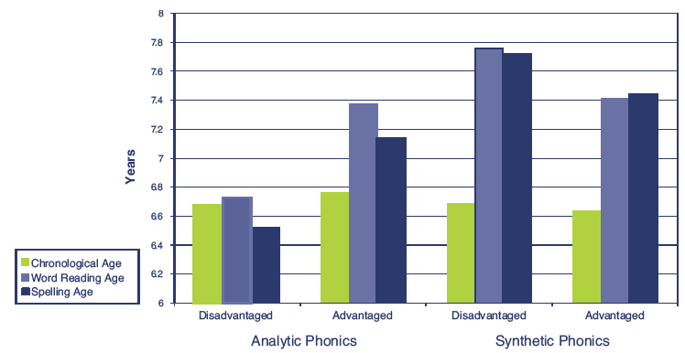
What about synthetic phonics?
Clackmannanshire study – Johnston & Watson (2005)
Very influential in Rose Report recommendations that synthetic phonics is best approach
7 year study based in primary schools in Scotland
3 groups: 1. Synthetic phonic approach 2. Whole word approach 3. Analytic phonics
The synthetic phonics approach as part of the reading curriculum is more effective than the analytic phonics approach
http://www.gov.scot/Publications/2005/02/20682/52383
Notes:
Lots of research evaluating synthetic phonics approach. As this is the focus of the RWI approach, will consider evidence base for this. Decided to focus on some of the main studies that were influential in informing government’s current focus on synthetic phonics…
Clackmannanshire study (Johnston & Watson) – Very influential in the Rose report’s recommendations that synthetic phonics was best approach. This was a seven year study based on schools in Clackmannanshire. Looked at effectiveness of synthetic phonics programme in teaching reading and spelling. Around 300 children in Primary 1 (Reception) were divided into three groups.
Main findings:
Figure - Comparison of children from advantaged and disadvantaged backgrounds learning to read by analytic or synthetic phonics, at the end of year 1. with analytic phonics tuition the advantaged children read and spelt significantly better than the disadvantaged children. However, with synthetic phonics teaching there was no difference in word reading or spelling ability according to social background.
Concluded… ‘‘the synthetic phonics approach, as part of the reading curriculum, is more effective than the analytic phonics approach’’
Important to note research actually consisted of two experiments that had been previously reported, followed by several years of further testing of the children. These had already been reported in a peer-reviewed journal article in 2004 but the new data, from the further testing of children after that date is only available online and has not been peer reviewed.
Methodological flaws –The experience and effectiveness of the people implementing the programmes was not adequately controlled. When look more carefully at what was involved in each group, the synthetic phonics intervention group were taught more and had more input than the comparison groups,(their teaching group was the only one to be taught to read the words independently) which may have influenced results.
Also, other things were going on in the schools that were not mentioned in the research, for example funding for books, staff development on literacy.

Slide 10
What about synthetic phonics?
A systematic review of the research literature on the use of phonics in the teaching of reading and spelling - Torgerson, Brooks & Hall (2006)
Systematic review. Inclusion criteria: Randomised Control Trials of interventions that focused on teaching of phonics; Measured reading as an outcome
Found evidence that systematic phonics teaching was associated with better progress in reading accuracy. No significant effect for reading comprehension.
Did report no significant difference in the effect of synthetic vs analytic phonics teaching
Notes:
Torgerson, Brooks and Hall (2006) A systematic review of experimental research on the use of phonics instruction in teaching of reading and spelling. Inclusion criteria were studies that used Randomised Control Trials that focused on teaching of phonics and compared effectiveness of instruction using systematic phonics vs unsystematic or no phonics instruction. Also, that measured reading as outcome and were interventions that could be found in schools. Identified 20 that met criteria, only one of which was UK based. 14 were used in main analysis.
Looking at systematic phonics – teaching letter-sound relationships in organised and explicit way – can apply to both synthetic and analytic phonics.
Did find evidence that systematic phonics teaching associated with better progress in reading accuracy BUT no significant effect for reading comprehension.
In terms of analytic vs synthetic phonics. There were only three small RCTs that this comparison could be based on. Did report that there was no evidence for either approach being superior and no significant different found between them. This is interesting, as in the Rose report this study is referred to and used as evidence that synthetic approach is superior.
Conclusion: Evidence in review does not suggest reading should be exclusively taught using a phonics approach. Instead, moderate evidence that systematic phonics approach should be used within broader literacy curriculum.
There is an argument that the Rose report places too much weight on synthetic phonics. International research support that systematic phonics instruction is important in early reading programmes. Although, there is a lack of experimental studies with control groups that identify the important of various factors of systematic phonics instruction. BUT the synthetic phonics approach being superior to other systematic approaches does not have as much support from research evidence.
Again, this is interesting as when looking at government papers (such as Reading by Six), they use the terms systematic and synthetic interchangeably in the report and claim they are the same thing.

Slide 11
What about reading schemes?
Real books vs reading schemes: a new perspective from instructional psychology - Solity & Vousden (2009)
- Identify some disadvantages with the systematic nature of reading schemes
Primary goal of reading becomes about getting through the reading scheme, as opposed to deriving enjoyment and meaning
Choice of reading material severely restricted.
Limited vocabulary in books reduces opportunities to use books as means to increase children’s vocabulary and general knowledge
Levy (2009) carried out longitudinal research, looking at young children’s definitions of reading and development of their self-concepts as readers.
Supported Solity & Vousden’s arguments. Reading schemes impacted negatively on children’s confidence and enjoyment of reading. Also, influenced children’s definitions of reading.
Notes:
Choice of reading material severely restricted. Have to wait to acquire new skills between books & may spend less time practising and applying skills
Solity & Vousden (2009) Analysed structures of adult books, children’s real books and reading schemes. Looking at demands they make on children’s sight vocabulary and phonic skills.
Identified that real books offer children same opportunities to develop sight vocabulary and phonic skills as reading schemes.
Identified an ‘optimal level’ of core phonological, phonic, and sight vocabulary skills that should be taught rigorously and systematically in conjunction with the use of real books, to support children to read effectively.

Slide 12
Anything else?
Training
One of the only programmes to offer whole school training packages.
Importance of developing shared knowledge and an inclusive approach in schools (De Coster, Baidak, Motiejunaite & Noora, 2011)
BUT does Read Write Inc limit teachers understanding to one approach rather than developing reflective, research-oriented practice?
Hall & Harding (2003) Teachers way of working is more important than reliance on a particular package of materials.
Notes:
Read Write Inc programme lists some other key principles. Think about these, as part of what makes it ‘unique’
Training - Read write inc is one of the only commercial programmes that offers whole school training packages. Provides professional development for teachers, can access ongoing training and development days.
Eurydice study which looked at reading practices across Europe - For CPD of teachers in reading, highlighted importance of developing shared knowledge and an inclusive approach. However RWI perhaps limits teachers understanding to one approach rather than developing reflective, research-oriented practice.
Hall & Harding (2003) A systematic review of effective literacy teaching in the 4 to14 age range of mainstream schooling. Research suggests that effective teachers of literacy consciously and skilfully balance direct skills instruction with more holistic, contextually grounded literacy activities. There is no single best method for teaching literacy that works for all children. Successful teachers tailor their teaching to suit individual circumstances; they build up knowledge of their learners and use that knowledge to advance their skills and understanding. Teachers’ ways of working can be more important than reliance on a particular package of materials

Slide 13
Conclusions
Read, Write Inc. is one of the most widely used phonic programmes in UK primary schools
Limited evidence, mainly from case studies, that RWI supports phonic skills
EPs should work with teaching staff to develop their understanding of a range of useful strategies. Also, to encourage them to use a wide range of literary texts and resources to promote reading for pleasure and interest
Notes:
Systematic phonics instruction by itself does not help students acquire all the processes they need to become successful readers. Learning about phonics is a tiny part of learning to read. Acquisition of reading is a complex process. Research shows acquisition of reading skills can be influenced by variety of factors. Learning to read requires a high degree of effort and motivation. High reading motivation and positive attitudes towards reading are associated with higher reading achievement and frequent reading (Baker & Wigfield, 1999).
Current trend of synthetic phonics – government big on this, perhaps to the detriment of other approaches & areas of literacy. Wonder about the influence of the phonics screening test. Are schools experiencing downward pressure to implement reading schemes, such as Read Write Inc?
Teachers should use a wide range of literary texts (fiction/non-fiction books and magazines and newspapers), not rely on reading scheme books. Integrates skills teaching with more authentic, contextually-grounded literacy activities, responding to the interests of the learner and the literacy contexts of their homes and communities’’ Motivation! Especially for readers who take longer to complete the scheme
Evidence indicates that some teaching strategies are more effective in the acquisition of reading than others, no one approach of itself can address the complex nature of reading difficulties. An integrated approach requires that teachers have a thorough understanding of a range of effective strategies, as well as knowing when and why to apply them’.
Very clear message that must be consistent/whole school… what about the individuals who don’t succeed? Need a different style of teaching?

Slide 14
“The more that you read, the more things you will know. The more that you learn, the more places you'll go” ― Dr. Seuss

